Slide 1
Chapter 5
Finite-Length Discrete Transforms

Slide 2
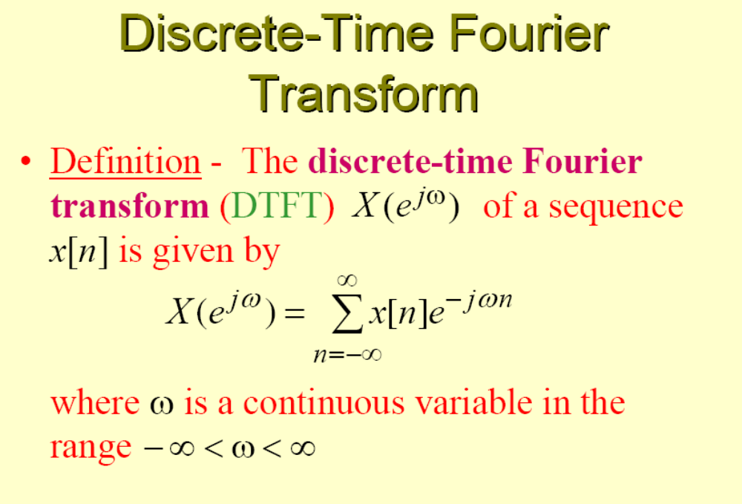

Slide 3
The Discrete Fourier Transform (DFT)
DTFT is the Fourier Transform of discrete-time sequence. It is discrete in time domain and its spectrum is periodical, but continue which cannot be processed by computer which could only process digital signals in both sides, that means the signals in both sides must be both discrete and periodical.

Slide 4
Discrete Fourier Transform (DFT)
Time domain Frequency domain
Continue Aperiodical ← CTFT→Continue Aperiodical
Discrete Aperiodical ← DTFT → Periodical Continue
Discrete Periodical ← DFT → Periodical Discrete

Slide 5
Typical DFT Pair δ_{T}(t) ←→ ω₀δω₀(ω)
δ_{T}(t)
ω₀ = 2π/T
ω₀δ_{ω0}(ω)
←→
-2T
-T
0
T
2T
t
-2ω₀
- ω₀
0
ω₀
2ω₀
ω
In DFT, the signals in both sides are discrete, so it is the only transform pair which can be processed by computer.
The signals in both sides are periodical, so the processing could be in one period, which is important because (1) the number of calculation is limited, which is necessary for computer; (2) all of the signal information could be kept in one period, which is necessary for accurate processing.

Slide 6


Make a signal discrete and periodical
x(t)
X(jω)
CTFT
P(t)
P(jω)
…
…
ω₀=2π/T_{s}
T_{s}
ω₀
x[nT]
X(jω)
DTFT
q(t)
Q(jω)
Q(jω)
…
…
…
…
Ω₀= 2π/T
Ω₀= 2π/T
T
Ω₀
Ω₀
DFT

Slide 7
Make a signal discrete and periodical
The engineering signals are often continue and aperiodical. If we want to process the signals with DFT, we have to make the signals discrete and periodical.
Sampling to make the signal discrete
Make the signal periodical:
If x[n] is a limited length N-point sequence, see it as one period of a periodical signal that means extend it to a periodical
If x[n] is an infinite length sequence, cut-off its tail to make a N-point sequence, then do the periodic extending. The tail cutting-off will introduce distortion. We must develop truncation algorithm to reduce the error, which is windowing.

Slide 8
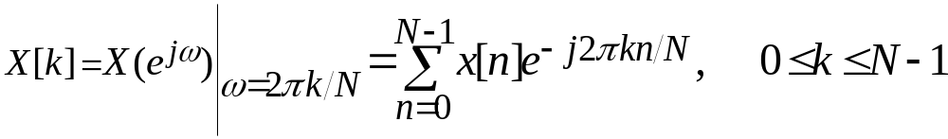
Definition (DFT)
Definition - The simplest relation which can be obtained by uniformly sampling DTFT X(e^{jω}) of a length-N sequence x[n], defined for 0≤n ≤N-1 on the ω-axis between 0≤ω ≤2π at ω_{k}=2πk/N , 0≤k≤N-1
From the definition of the DTFT have

Slide 9
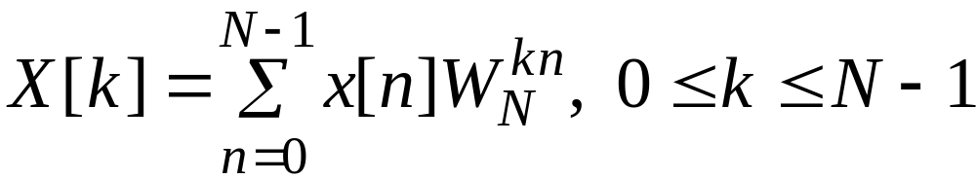
Definition (DFT)
Note: X[k] is also a length-N sequence in the frequency domain
The sequence X[k] is called the discrete Fourier transform (DFT) of the sequence x[n]
Using the notation W_{N}=e^{-j2 π/N} , the DFT is usually expressed as:

Slide 10
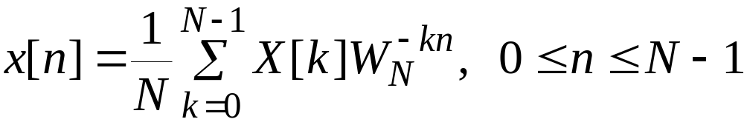
Definition (DFT)
The inverse discrete Fourier transform (IDFT) is given by

Slide 11
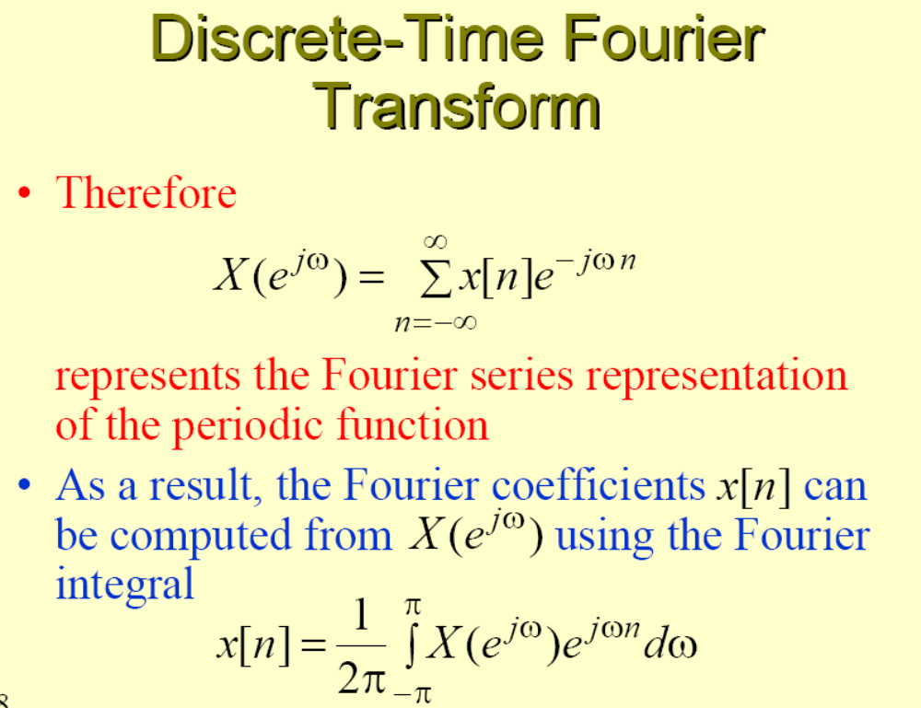

Slide 12
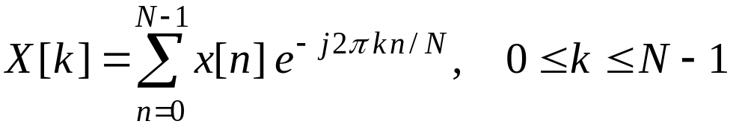


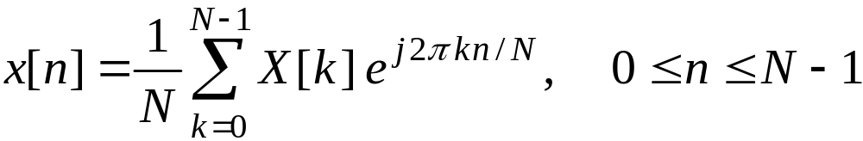
Definition (DFT)
DFT: analysis equation
time domain
frequency domain
IDFT: synthesis equation

Slide 13
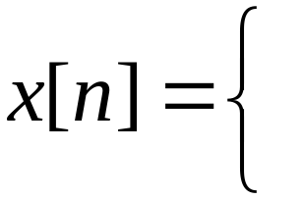
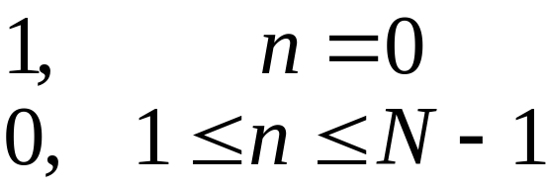
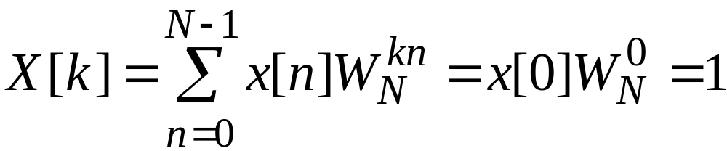

Definition (DFT)
Example 5.1 - Consider the length-N sequence
Its N-point DFT is given by

Slide 14
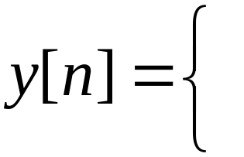
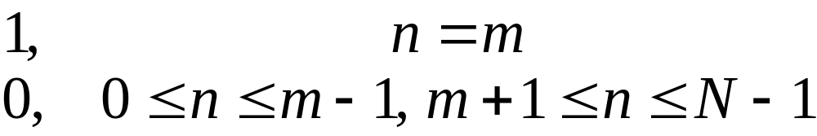
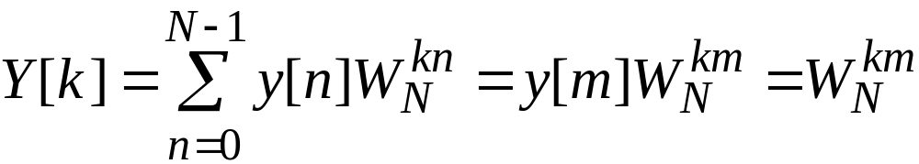
Definition (DFT)
Now consider the length-N sequence
Its N-point DFT is given by
W_{N}=e^{-j2 π/N}

Slide 15
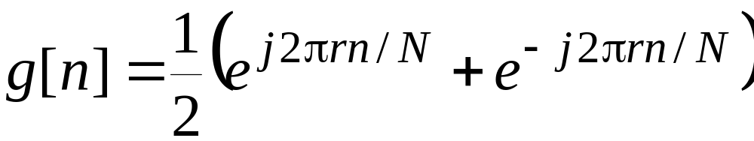
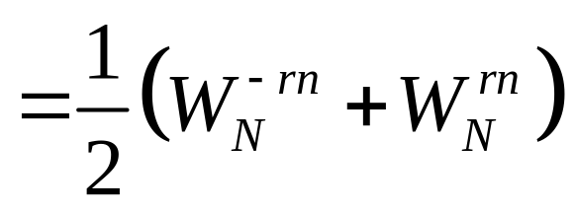
Definition (DFT)
Example 5.2- Consider the length-N sequence defined for 0 ≤n ≤N-1
Using a trigonometric identity we can write
三角恒等式

Slide 16
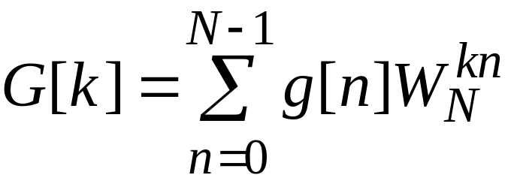
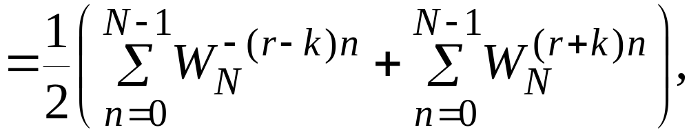
Definition (DFT)
The N-point DFT of g[n] is thus given by

Slide 17
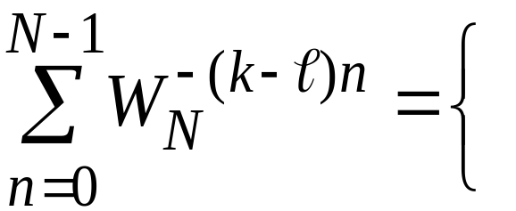



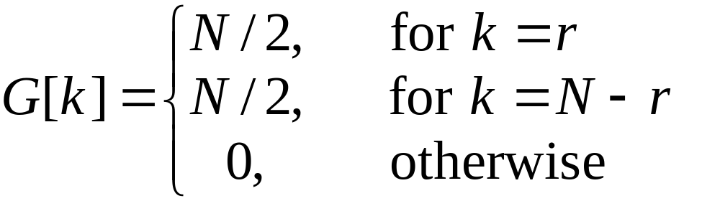
Definition (DFT)
Making use of the identity
r an integer
we get

Slide 18
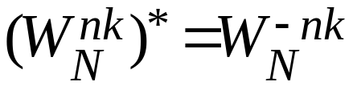
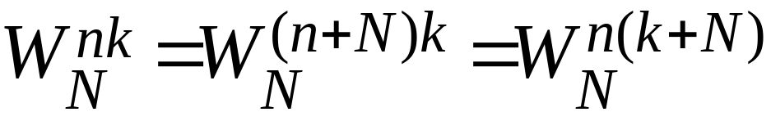
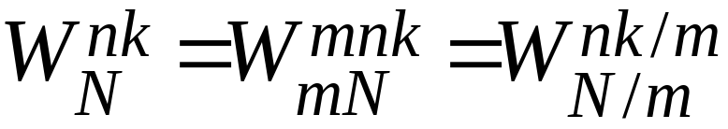
Definition (DFT)
symmetry
periodicity
divisibility

Slide 19
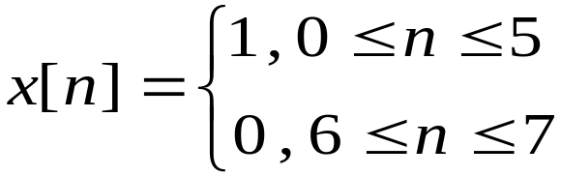
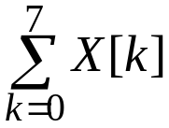
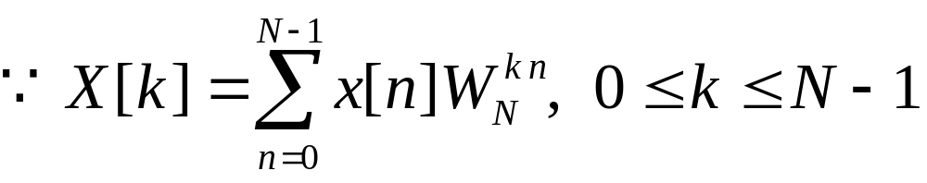
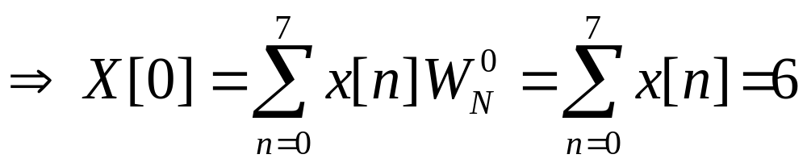
Definition (DFT)
Example- Consider the length-8 sequence defined for , its 8-point DFT is
X[k], Determine the values of X[0], X[4] and
,

Slide 20
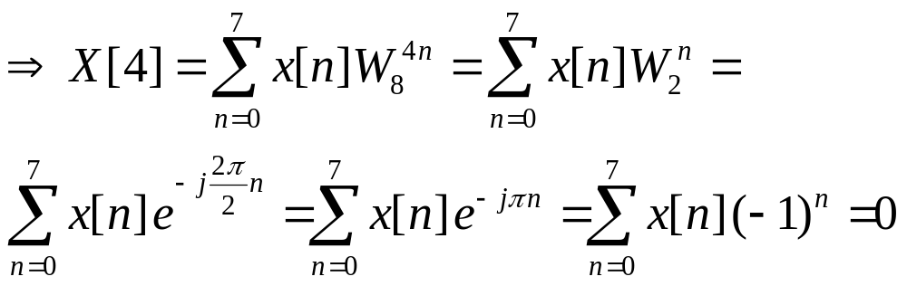
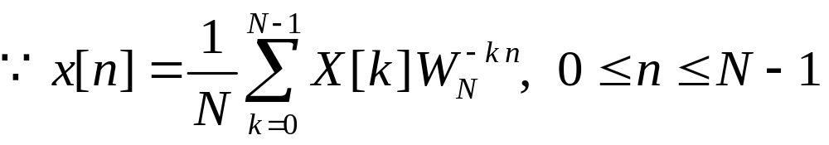
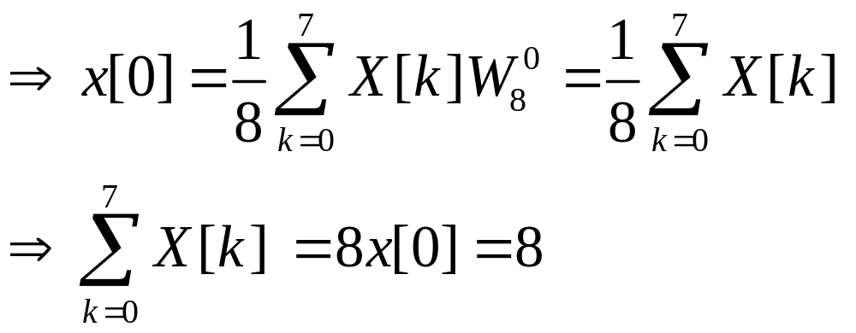
Definition (DFT)
,

Slide 21
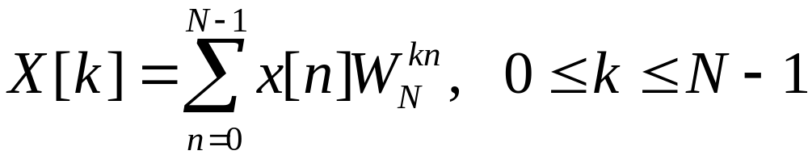

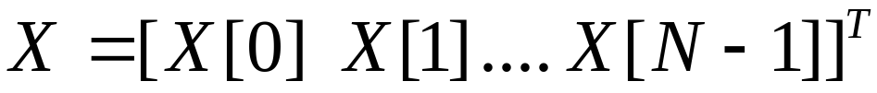
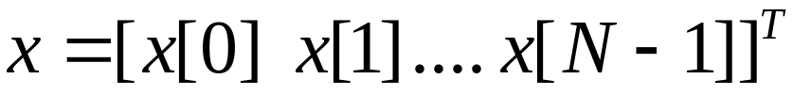
Matrix Relations
The DFT samples defined by
Can be expressed in matrix form as
where

Slide 22

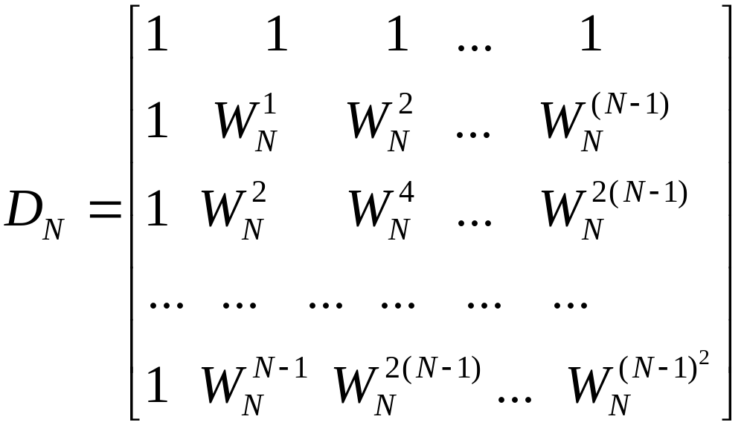
Matrix Relations
is the N×N DFT matrix given by

Slide 23
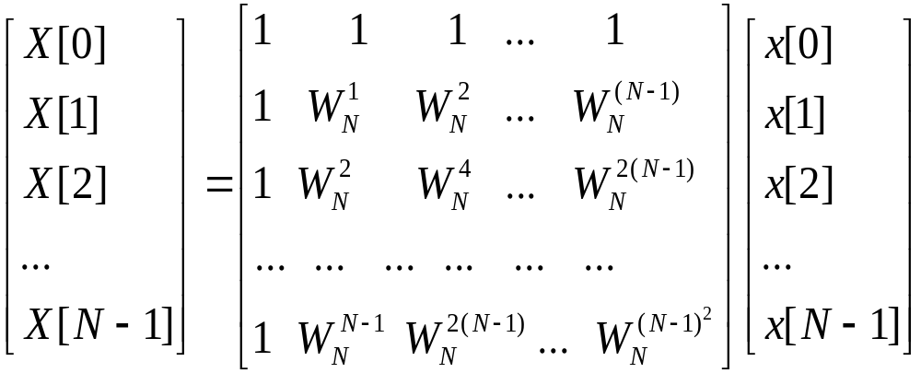
Matrix Relations

Slide 24
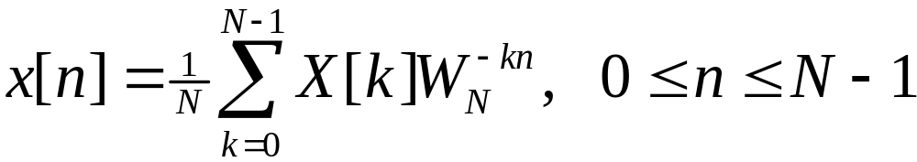
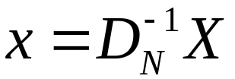
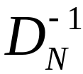
Matrix Relations
Likewise, the IDFT relation given by
Can be expressed in matrix form as
Where is N×N IDFT matrix

Slide 25
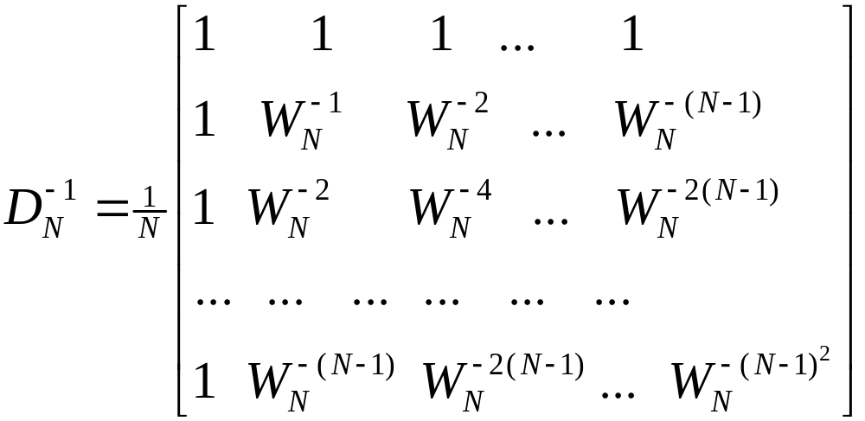

Matrix Relations
where
Note

Slide 26
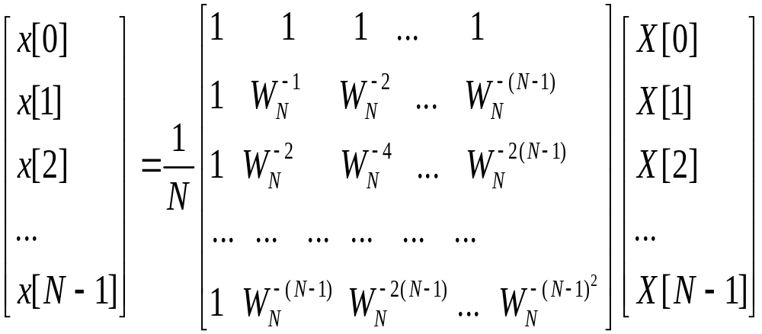
Matrix Relations

Slide 27
DFT Computation Using MATLAB
The functions to compute the DFT and the IDFT are FFT and IFFT
These functions make use of FFT algorithms which are computationally highly efficient compared to the direct computation
Programs 5_1.m and 5_2.m illustrate the use of these functions

Slide 28
Relation Between the DTFT and the DFT, and Their Inverses
We now examine the relation between the DTFT and the N-point DFT of a length-N sequence, and the relation between the DTFT of length-M sequence and the N-point DFT obtained by sampling the DTFT.

Slide 29

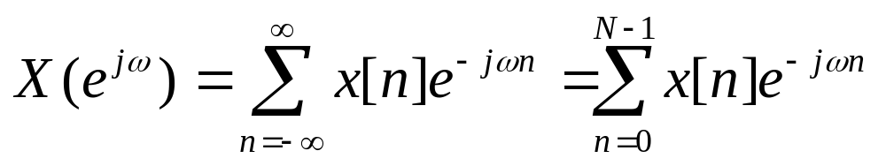

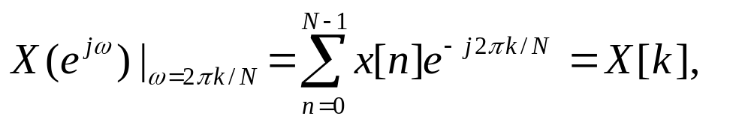
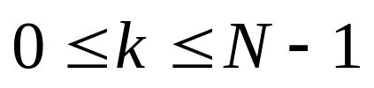
Relation with the DTFT
The DTFT of the length-N sequence x[n], defined for 0≤n≤N-1, is given by
By uniformly sampling at N equally spaced frequency on the ω-axis between 0 ≤ ω<2π, we get

Slide 30
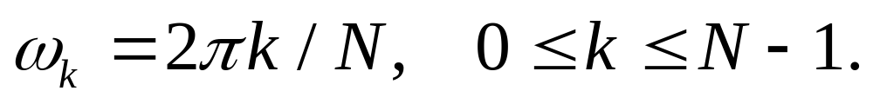
Relation with the DTFT
We observe that the N-point DFT sequence X[k] is precisely the set of frequency samples of the DTFT of the length-N sequence x[n] at N equally spaced frequencies:

Slide 31
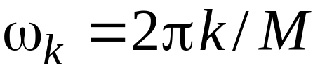

Numerical Computation of the DTFT Using the DFT
A practical approach to the numerical computation of the DTFT of a finite-length sequence
Let be the DTFT of a length-N sequence x[n]
We wish to evaluate on a dense grid of frequencies
where M >> N:

Slide 32
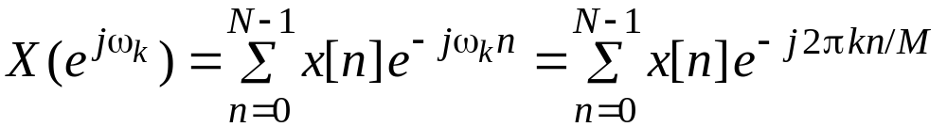
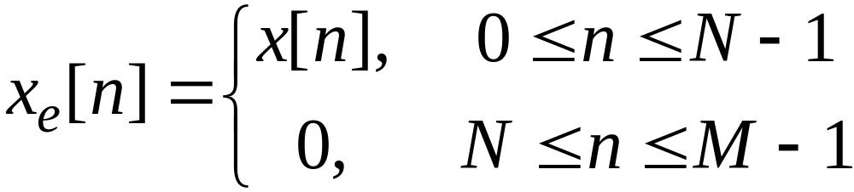
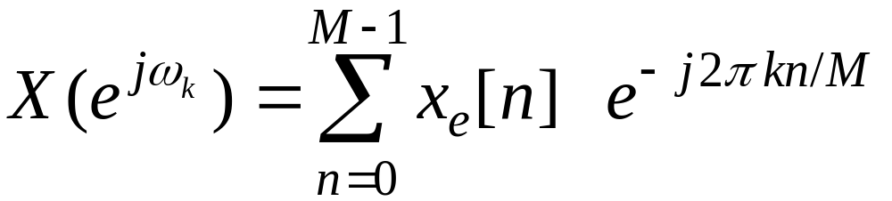
Numerical Computation of the DTFT Using the DFT
Define a new sequence
Then

Slide 33
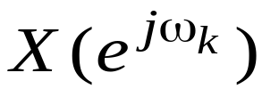

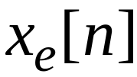
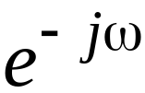
Numerical Computation of the DTFT Using the DFT
Thus is essentially an M-point DFT of the length-M sequence
The DFT can be computed very efficiently using the FFT algorithm if M is an integer power of 2
The function freqz employs this approach to evaluate the frequency response at a prescribed set of frequencies of a DTFT expressed as a rational function of

Slide 34


Slide 35

DTFT from DFT by Interpolation
The N-point DFT X[k] of a length-N sequence x[n] is simply the frequency samples of its DTFT evaluated at N uniformly spaced frequency points
Given the N-point DFT X[k] of a length-N sequence x[n], its DTFT can be uniquely determined from X[k]

Slide 36



DTFT from DFT by Interpolation
Thus

Slide 37


DTFT from DFT by Interpolation
It can readily be shown that

Slide 38




Sampling the DTFT
Consider a sequence x[n] with a DTFT
We sample at N equally spaced points , 0≤k ≤N-1 developing the N frequency samples
These N frequency samples can be considered as an N-point DFT Y[k] whose N-point IDFT is a length-N sequence y[n], 0≤n ≤N-1

Slide 39




Sampling the DTFT
Now
Thus
An IDFT of Y[k] yields

Slide 40





Sampling the DTFT
i.e.
Making use of the identity

Slide 41


Sampling the DTFT
we arrive at the desired relation
Thus y[n] is obtained from x[n] by adding an infinite number of shifted replicas of x[n], with each replica shifted by an integer multiple of N sampling instants, and observing the sum only for the interval

Slide 42

Sampling the DTFT
To apply
to finite-length sequences, we assume that the samples outside the specified range are zeros
Thus if x[n] is a length-M sequence with , then y[n] = x[n] for

Slide 43



Sampling the DTFT
If M > N, there is a time-domain aliasing of samples of x[n] in generating y[n], and x[n] cannot be recovered from y[n]
Example - Let
By sampling its DTFT at , and then applying a 4-point IDFT to these samples, we arrive at the sequence y[n] given by

Slide 44


Sampling the DTFT
,
i.e.
{x[n]} cannot be recovered from {y[n]}

Slide 45


Slide 46


Slide 47
DFT Theorems
Like the DTFT, the DFT also satisfies a number of properties that are useful in signal processing applications
Some of these properties are essentially identical to those of the DTFT, while some others are somewhat different
A summary of the DFT properties are given in tables in the following slides

Slide 48



DFT Theorems
Type of Property length-N sequence N-point DFT
g[n] G[k]
h[n] H[k]
Linearity αg[n]+βh[n] αG[k]+βH[k]
Circular Time-shifting g[⟨n-n₀⟩_{N}] W_{N}^{kn0}G[k]
Frequency-shifting W_{N}^{-k0n}g[n] G[⟨k-k₀⟩_{N}]
Duality G[n] N[g⟨-k⟩_{N}]
Circular Convolution
G[k]H[k]
Modulation g[n]h[n]
Parseval’s relation

Slide 49
Operations on Finite-Length Sequences
Like the DTFT, the DFT also satisfies a number of properties that are useful processing applications. Some of these properties are essentially identical to those of the DTFT, while some others are somewhat different.
We first point out the differences between two important operations on sequences and then review the properties of the DFT.

Slide 50
Circular Shift of a Sequence
This property is analogous to the time-shifting property of the DTFT , but with a subtle difference
Consider length-N sequences defined for
0≤n≤N-1
Sample values of such sequences are equal to zero for values of n < 0 and
n≥N

Slide 51
Circular Shift of a Sequence
If x[n] is such a sequence, then for any arbitrary integer n₀ , the shifted sequence
x₁[n] = x[n – n₀]
is no longer defined for the range 0≤n≤N-1
We thus need to define another type of a shift that will always keep the shifted sequence in the range 0≤n≤N-1

Slide 52



Circular Shift of a Sequence
The desired shift, called the circular shift, is defined using a modulo operation:
For n₀>0 (right circular shift), the above equation implies

Slide 53






Circular Shift of a Sequence
Illustration of the concept of a circular shift

Slide 54
Circular Shift of a Sequence
As can be seen from the previous figure, a right circular shift by n₀ is equivalent to a left circular shift by N-n₀ sample periods
A circular shift by an integer number n₀ greater than N is equivalent to a circular shift by ⟨n₀⟩ _{N}

Slide 55

Circular Convolution
This operation is analogous to linear convolution, but with a subtle difference
Consider two length-N sequences, g[n] and h[n], respectively
Their linear convolution results in a length-(2N-1) sequence y_{L}[n] given by

Slide 56
Circular Convolution
In computing y_{L}[n] we have assumed that both length-N sequences have been zero-padded to extend their lengths to 2N-1
The longer form of y_{L}[n] results from the time-reversal of the sequence h[n] and its linear shift to the right
The first nonzero value of y_{L}[n] is y_{L}[0]=g[0]h[0], and the last nonzero value is
y_{L}[2N-2]=g[N-1]h[N-1]

Slide 57

Circular Convolution
To develop a convolution-like operation resulting in a length-N sequence y_{C}[n], we need to define a circular time-reversal, and then apply a circular time-shift
Resulting operation, called a circular convolution, is defined by

Slide 58
Circular Convolution
Since the operation defined involves two length-N sequences, it is often referred to as an N-point circular convolution, denoted as
y[n] = g[n] h[n]
N
The circular convolution is commutative, i.e.
g[n] h[n] = h[n] g[n]
N
N

Slide 59






Circular Convolution
Example - Determine the 4-point circular convolution of the two length-4 sequences:
as sketched below
n
n

Slide 60


Circular Convolution
The result is a length-4 sequence y_{C}[n] given by
4
From the above we observe

Slide 61


Circular Convolution
Likewise

Slide 62



Circular Convolution
The circular convolution can also be computed using a DFT-based approach

Slide 63

Circular Convolution
Example - Consider the two length-4 sequences repeated below for convenience:
n
n
The 4-point DFT G[k] of g[n] is given by

Slide 64






Circular Convolution
Therefore
Likewise,

Slide 65


Circular Convolution
Hence,
The two 4-point DFTs can also be computed using the matrix relation given earlier

Slide 66



Circular Convolution
is the 4-point DFT matrix

Slide 67




Circular Convolution
If denotes the 4-point DFT of then from Table 5.3 we observe
Thus

Slide 68


Circular Convolution
The 4-point IDFT of yields

Slide 69


Circular Convolution
Example - Now let us extended the two length-4 sequences to length 7 by appending each with three zero-valued samples, i.e.

Slide 70





Circular Convolution
We next determine the 7-point circular convolution of and :
From the above

Slide 71
Circular Convolution
Continuing the process we arrive at

Slide 72



Circular Convolution
As can be seen from the above that y[n] is precisely the sequence obtained by a linear convolution of g[n] and h[n]

Slide 73


Circular Convolution
The N-point circular convolution can be written in matrix form as
Note: The elements of each diagonal of the matrix are equal
Such a matrix is called a circulant matrix
循环行列式

Slide 74

Circular Convolution

Slide 75

Circular Convolution

Slide 76

Circular Convolution

Slide 77

Circular Convolution

Slide 78
Computation of the DFT of Real Sequences
In most practical applications, sequences of interest are real. In such cases, the symmetry properties of the DFT given in Tables 5.1 and 5.2 can be exploited to make the DFT computations more efficient.
The N-point DFTs of two length-N real sequences can be computed from a single N-point DFT of a length-N complex sequence formed from the two length-N real sequences;
The 2N-point DFT of a length-2N real sequence can be determined from a single N-point DFT of a length-N complex sequence formed from the length-2N real sequence.

Slide 79

N-point DFTs of Two Real Sequences Using a Signal N-Point DFT
Let g[n] and h[n] be two real sequences of length N each, with G[k] and H[k] denoting their respective N-point DFTs. These two N-point DFTs can be computed efficiently using a signle N-point DFT X[k] of a complex length-N sequence defined by
where, g[n]=Re{x[n]} and h[n]=Im{x[n]}

Slide 80


N-point DFTs of Two Real Sequences Using a Signal N-Point DFT
From Table 5.1, we arrive at
Note that

Slide 81

N-point DFTs of Two Real Sequences Using a Signal N-Point DFT
Example – Computation of the 4-point DFTs of the two length-4 real sequences:
We can form a N-point complex sequence x[n]:

Slide 82


N-point DFTs of Two Real Sequences Using a Signal N-Point DFT
Its DFT is then:
From the above, we have
Therefore

Slide 83


Then we get

Slide 84
2N-point DFT of a Real Sequences Using a Signal N-Point DFT
Let v[n] be a real sequences of length 2N with V[k] denoting its 2N-point DFT. Define two real sequences g[n] and h[n] of length-N each as
With G[k] and H[k] denoting their N-point DFTs.
Therefore, the 2N-point DFT V[k] has

Slide 85

2N-point DFT of a Real Sequences Using a Signal N-Point DFT

Slide 86

2N-point DFT of a Real Sequences Using a Signal N-Point DFT

Slide 87


Slide 88


Slide 89


Slide 90


Slide 91
Linear Convolution Using the DFT
Linear convolution is a key operation in many signal processing applications
Since a DFT can be efficiently implemented using FFT algorithms, it is of interest to develop methods for the implementation of linear convolution using the DFT

Slide 92



Linear Convolution Using the DFT
Let g[n] and h[n] be two finite-length sequences of length N and M, respectively
Denote
Define two length-L sequences

Slide 93






Linear Convolution Using the DFT
Then
The corresponding implementation scheme is illustrated below
*
L
g[n]
Zero-padding
with
point DFT
Length-N
h[n]
Zero-padding
point IDFT
with
point DFT
Length-M
Length-

